Slide 1

6th Grade Accelerated Math
Unit 7, Lesson 1 Area of Triangles- Part 1 Volume 1, pg. 297

Slide 2


Benchmark
MA.6.GR.2.1
Derive a formula for the area of a right triangle using a rectangle. Apply a formula to find the area of a triangle.
volume 1, pg. 297

Slide 3
Integrated Mathematical Thinking and Reasoning Standards
MA.K12.MTR.1.1 Actively participate in effortful learning both individually and collectively.
MA.K12.MTR.2.1 Demonstrate understanding by representing problems in multiple ways.
MA.K12.MTR.4.1 Engage in discussions that reflect on the mathematical thinking of self and others.
MA.K12.MTR.5.1 Use patterns and structure to help understand and connect mathematical concepts.
volume 1, pg. 297

Slide 4

Learning Target
I can discover the formula for the area of a triangle.
volume 1, pg. 297

Slide 5

Warm-Up
volume 1, pg. 297

Slide 6
7.1.1 Warm-Up: The Importance of Struggle
When learning something new, whether it is a sport, a musical instrument, or even math, you may experience failure before you experience success. The key is to keep going even when you make mistakes. Learning takes place during the time you practice and during the time you struggle.
1. Which choice would you feel less comfortable doing?
Answering a question and getting it wrong.
Saying, “I do not know,” as your answer to a question.
2. Describe a time that you persevered when learning something new.
3. When you persevered in learning, how did you overcome any initial fear(s)?
volume 1, pg. 297

Slide 7

Exploration
volume 1, pg. 298

Slide 8

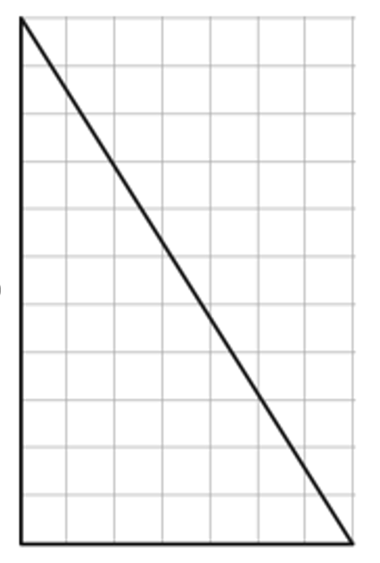
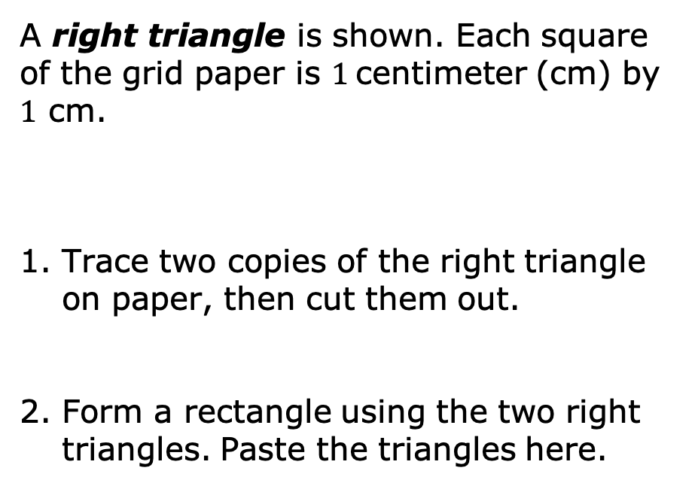
7.1.2 Exploration: Discovering the Area of a Right Triangle
A right triangle is shown. Each square of the grid paper is $1$centimeter (cm) by $1$ cm.
Trace two copies of the right triangle on paper, then cut them out.
Form a rectangle using the two right triangles. Paste the triangles here.
volume 1, pg. 298

Slide 9
3. Using the image just created, complete the table.
 | Rectangle | Triangle
Height | _____ cm | _____ cm
Base | _____ cm | _____ cm
volume 1, pg. 298

Slide 10
4. What is the area of the rectangle? Include units.
5. Describe the relationship between the area of one right triangle and the area of the rectangle.
6. What is the formula for the area of a rectangle?
7. Use the relationship observed and the formula for the area of a rectangle to write a formula that can be used to find the area of a right triangle.
volume 1, pg. 298

Slide 11

Collaboration
volume 1, pg. 299

Slide 12

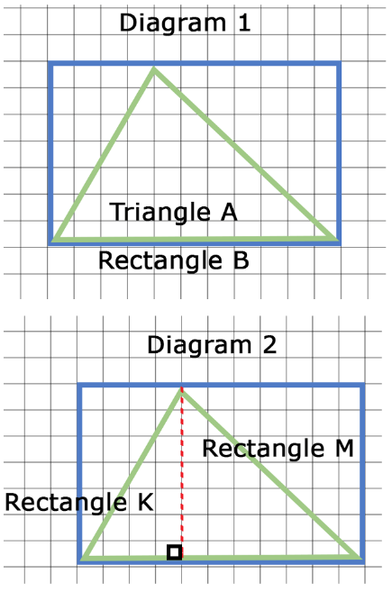
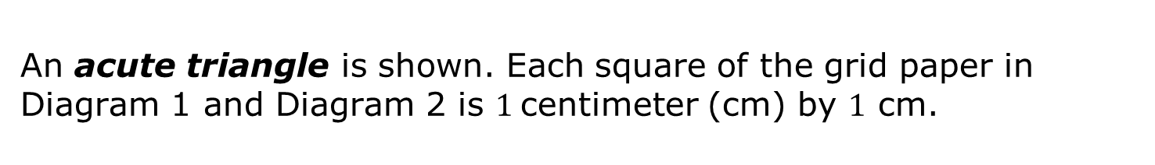
7.1.3 Collaboration: Area of an Acute and an Obtuse Triangle
An acute triangle is shown. Each square of the grid paper in Diagram 1 and Diagram 2 is $1$centimeter (cm) by $1$ cm.
Rectangle B is drawn around acute Triangle A, as shown.
The height of acute Triangle A is shown as a dashed red line. It divides Rectangle B into two smaller rectangles, Rectangle K and Rectangle M, and divides Triangle A into two smaller right triangles.
volume 1, pg. 299

Slide 13
1. Use the two diagrams to complete the table.
 | Area of the Rectangle | Area of the Right Triangle Drawn Inside the Rectangle
Rectangle K
Rectangle M
volume 1, pg. 299

Slide 14
2. The area of acute Triangle A is equal to the sum of the right triangle inscribed in Rectangle K and the right triangle inscribed in Rectangle M.
What is the area of acute Triangle A?
What is the area of Rectangle B?
What is the relationship between the area of Rectangle B and the area of acute Triangle A?
volume 1, pg. 299

Slide 15
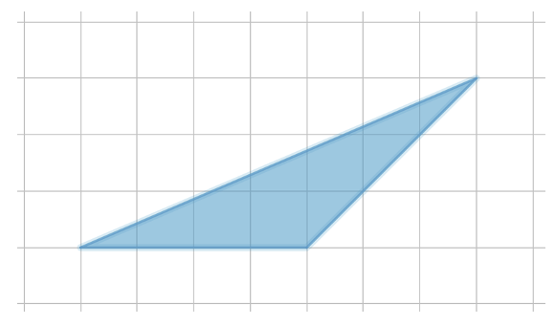
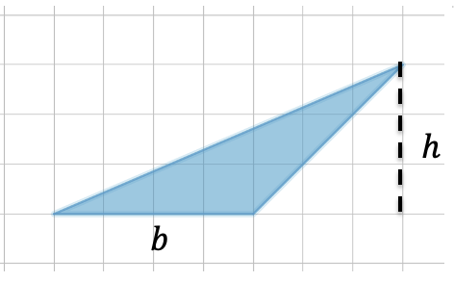
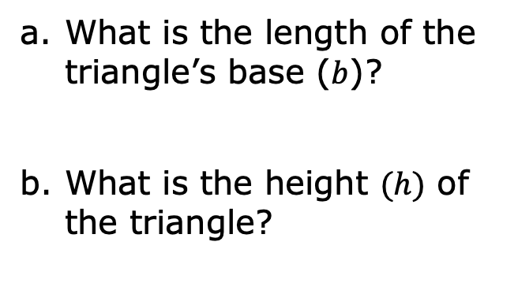
3. An obtuse triangle is shown. Each square of the grid paper is $1$ centimeter (cm) by $1$ cm.
What is the length of the triangle’s base ($b$)?
What is the height $(h)$ of the triangle?
volume 1, pg. 300

Slide 16
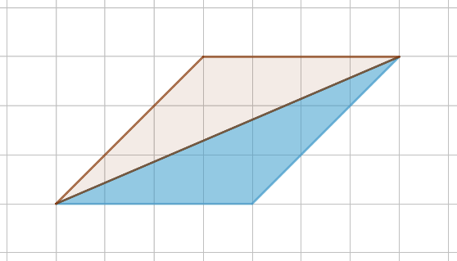
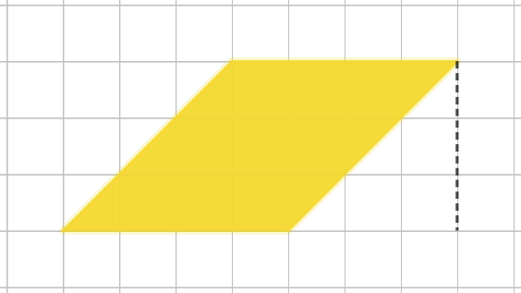
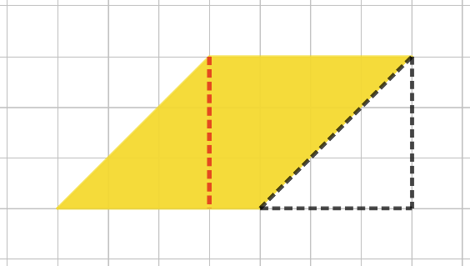
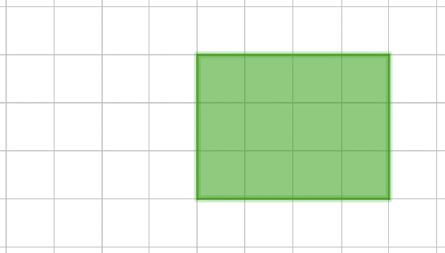

4. A copy of the triangle is made, and the two triangles are arranged to form a parallelogram with a base of $4$ cm and a height of $3$ cm, as shown.
The parallelogram is then decomposed, and the parts are rearranged to form a rectangle.
volume 1, pg. 300

Slide 17
Complete the table.
How many obtuse triangles were needed to create the rectangle?
 | Rectangle | Obtuse Triangle
Height | _____ cm | _____ cm
Base | _____ cm | _____ cm
volume 1, pg. 300

Slide 18
What is the area of the rectangle?
What is the relationship between the area of the rectangle and the obtuse triangle?
Based on this relationship, what is the area of the obtuse triangle?
volume 1, pg. 301

Slide 19

Bring It Together
volume 1, pg. 301

Slide 20

7.1.4 Bring It Together: Formula for the Area of a Triangle
1. Complete the statements.
The area of the right triangle was the area of
the rectangle with the same base and height.
The area of the acute triangle was the area of
the rectangle with the same base and height.
The area of the obtuse triangle was the area
of the rectangle with the same base and height.
half
the same as
half
the same as
half
the same as
volume 1, pg. 301

Slide 21
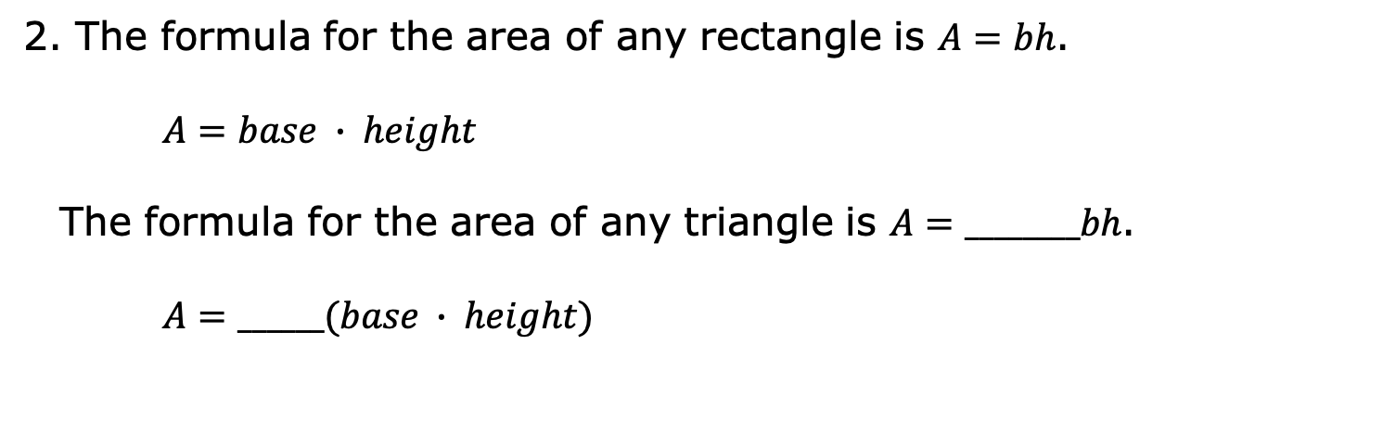
2. The formula for the area of any rectangle is $A=bh$.
$A=base ∙ height$
The formula for the area of any triangle is $A=________bh$.
$A=______(base ∙ height)$
volume 1, pg. 301

Slide 22

Wrap-Up
volume 1, pg. 302

Slide 23
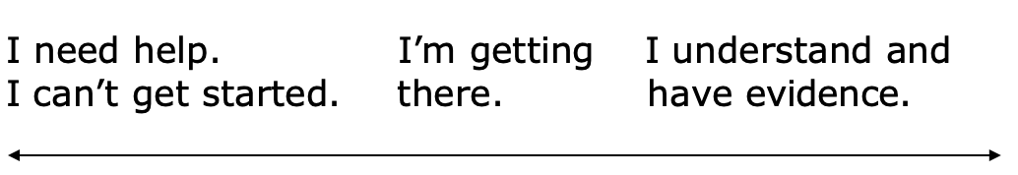
7.1.5 Wrap-Up: Reflection
Place an X on the line to indicate your mastery of today’s lesson.
I can explain why the area of a triangle is half the area of a rectangle with the same base and height for right triangles, acute triangles, and obtuse triangles.
2. Write a brief explanation of your placement of the X.
volume 1, pg. 302

